Slide 1
STEP PRESENTATION (AISC-2006) Week 4 Presentation
GROUP MEMBERS (Group A):
Laxmi Sharma
Niraj Rokaya (Leader)
Manish Chhetri
Sandesh Pandey
Instructor: Ana Serafimovic

Slide 2
Objective: Exploratory Data Analysis (EDA)

Slide 3
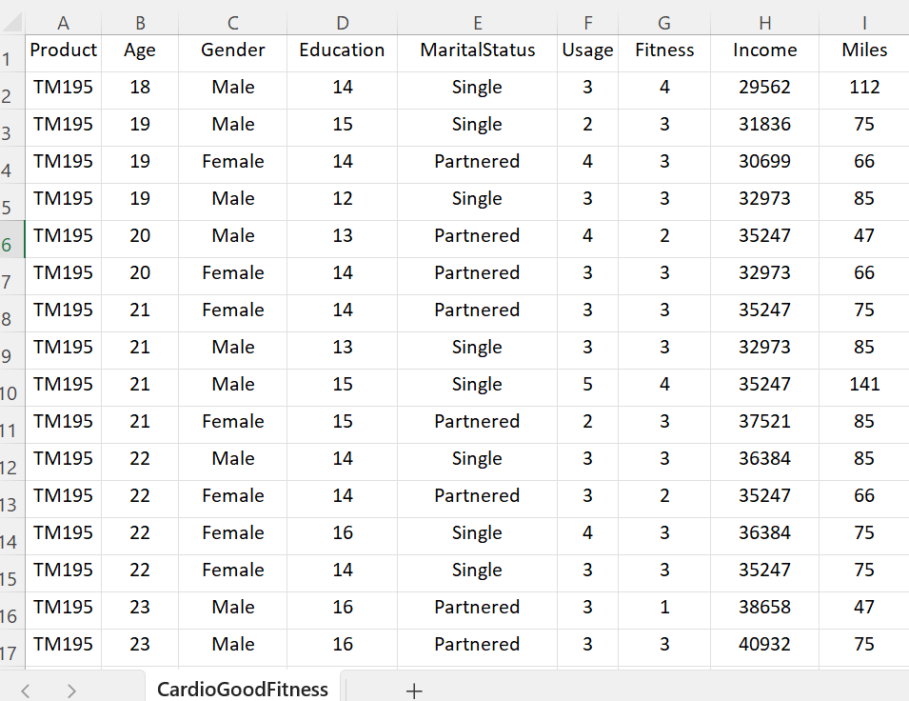
Data Description:
CardioGoodFitness.csv - Tt contains information about customers purchasing product.
Product - the model no. of the treadmill
Age - in no of years, of the customer
Gender - of the customer
Education - in no. of years, of the customer
Marital Status - of the customer
Usage - Avg. # times the customer wants to use the treadmill every week
Fitness - Self rated fitness score of the customer (5 - very fit, 1 - very unfit)
Income - of the customer
Miles- expected to run

Slide 4
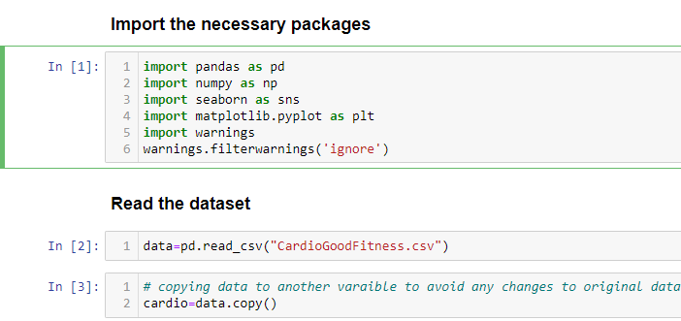
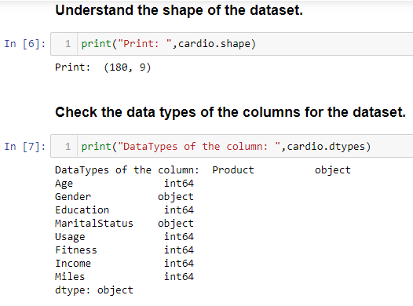
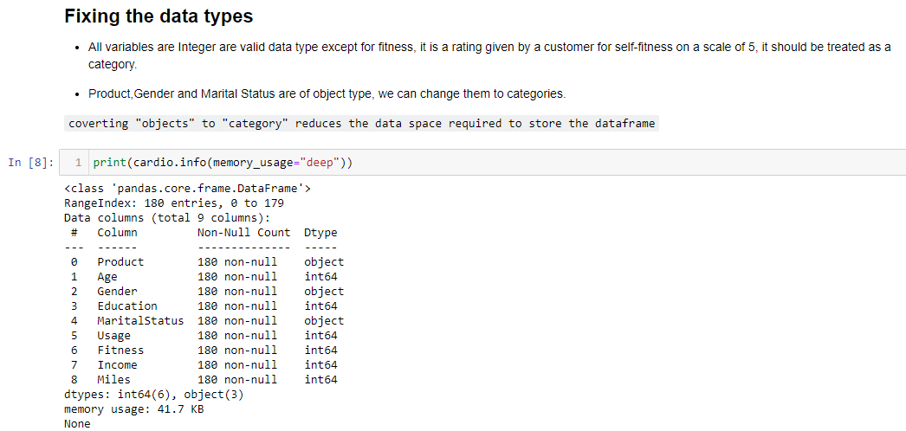
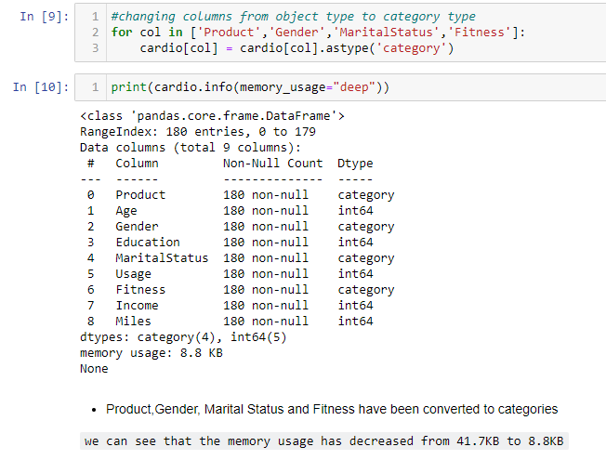

Slide 5
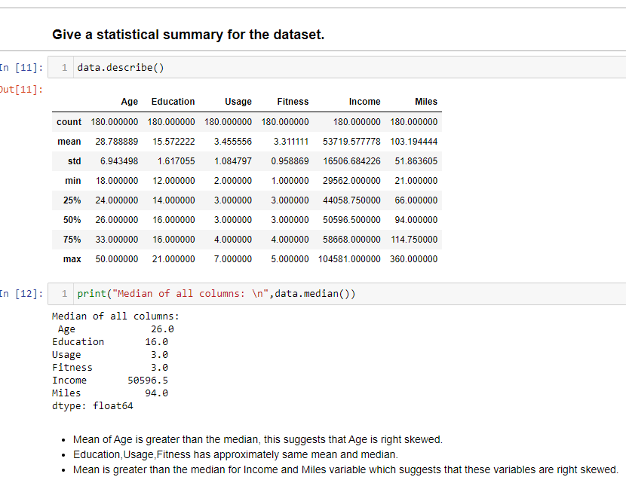

Slide 6
Week 7 - Objective: Data Analysis and Visualization

Slide 7
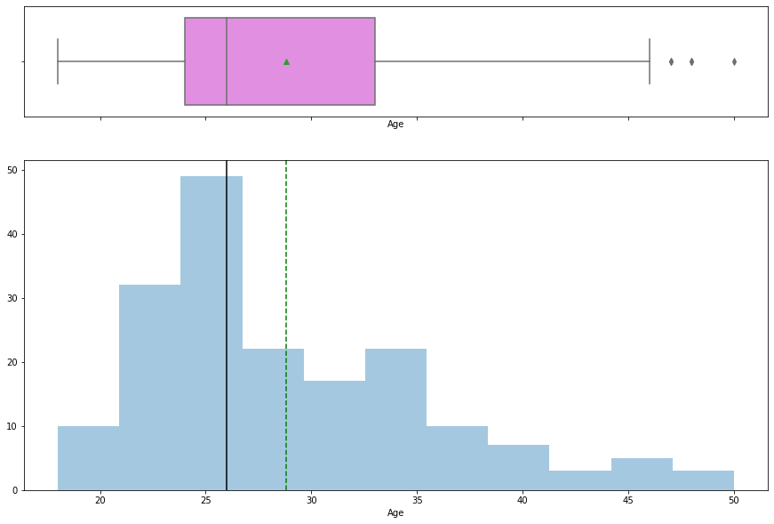
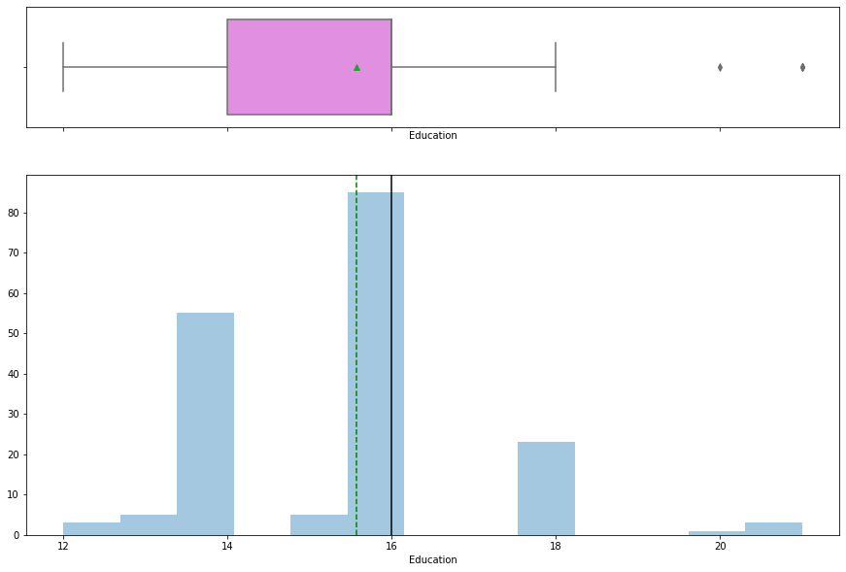

Slide 8
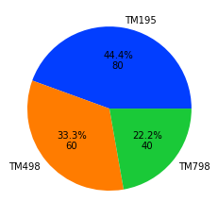
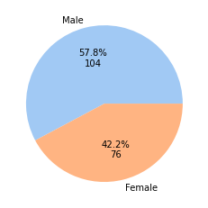
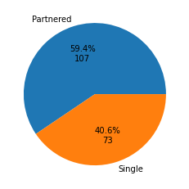
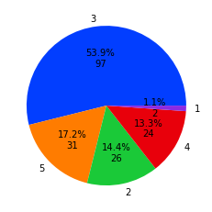
Product
Observations on
Gender
Marital Status
Fitness
Highest selling product is TM195(44.4%),followed by TM498(33.3%) and TM798(22.2%)
There are more male customers(57.8%) than females(42.2%)
40.6% of customers are single while 59.4% of customers have a partner.
53.9% of the customers have rated them at 3 on a scale of 5 (1 being the least fit and 5 being the most fit),followed by 5 rating (17.2%).

Slide 9
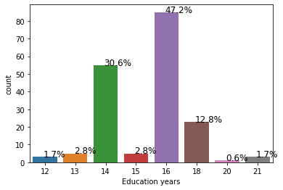
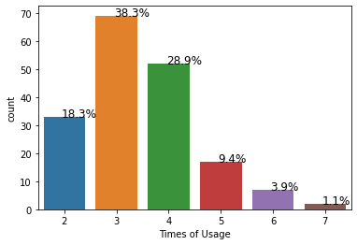
Education
Observations on
Usage
47.2% of customers have 16 years of education, followed by 14 years of education(30.6%).
38.3% of customers wish to use the product 3 times a week followed by 28.9% customers who wish to use the product 4 times a week.

Slide 10
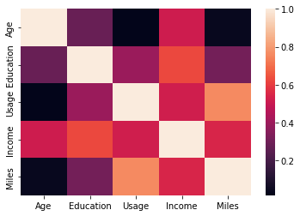
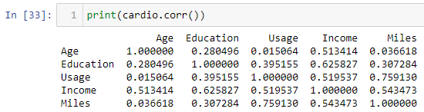
Bivariate Analysis
Miles is highly correlated with usage, a customer running more miles would mean he is also using the treadmill more.
Education and Income has a positive correlation, indicating higher the education higher would be the income.
Income shows a positive correlation with Age , Usage, and Miles.
A positive correlation between age and income is expected but a high poistive correlation of income with usage and miles should be investigated further.

Slide 11
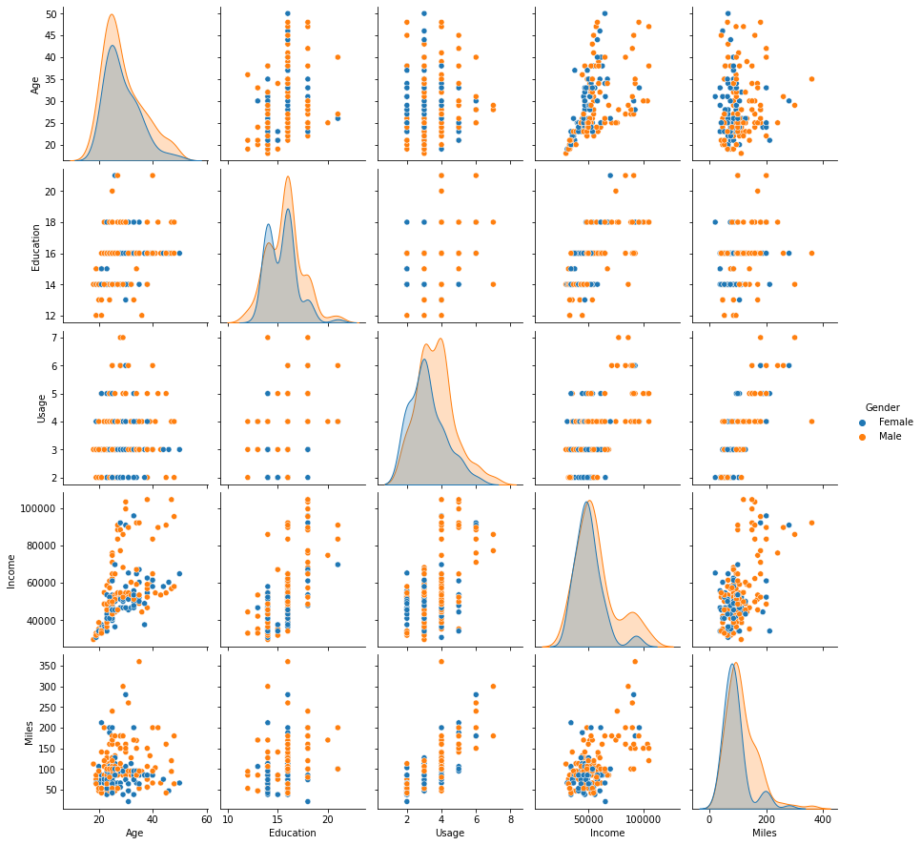
We can see varying distributions in variables for different products, we should investigate it further.

Slide 12
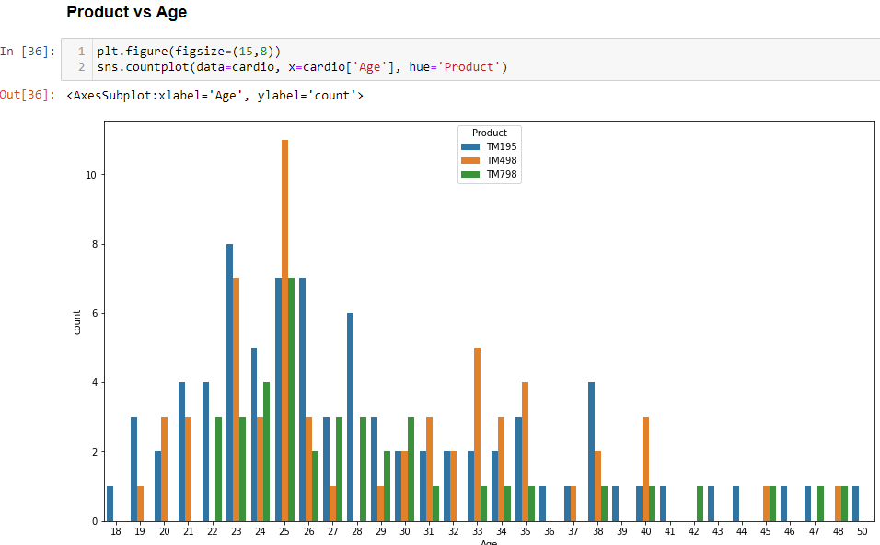

Slide 13
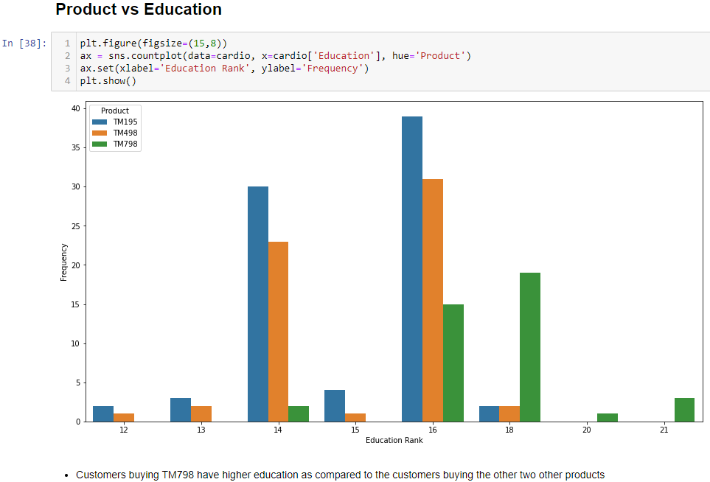

Slide 14
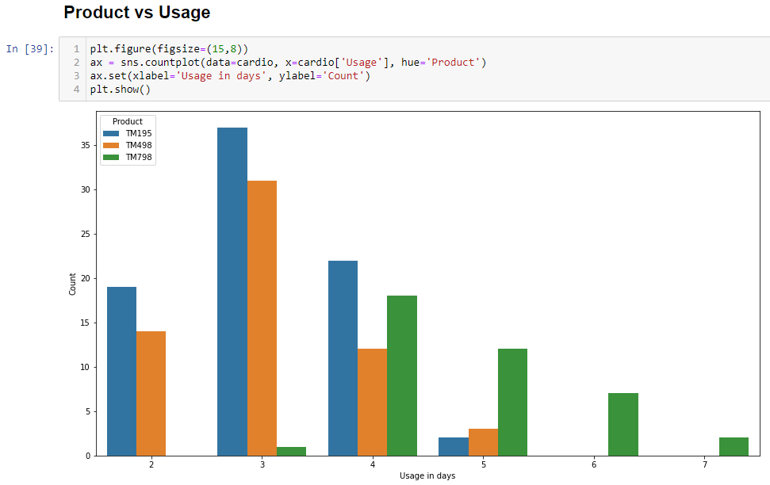
Customers who have higher expected treadmill usage(greater than 3 days) prefer the TM798 product, Customers with very light(2-3 days) usage prefer TM498, customers who have moderate usage (greater than 2 days but less than or equal to 5 days) prefer TM195.

Slide 15
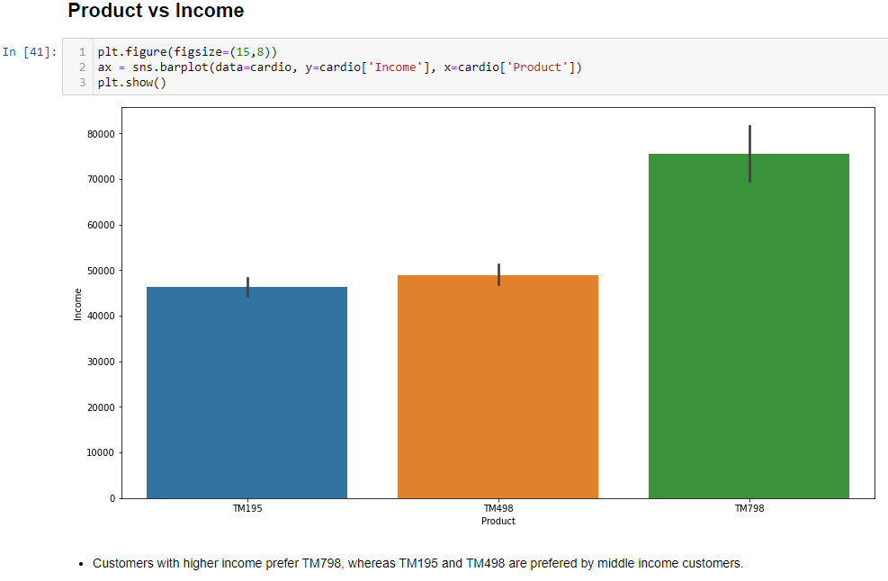

Slide 16
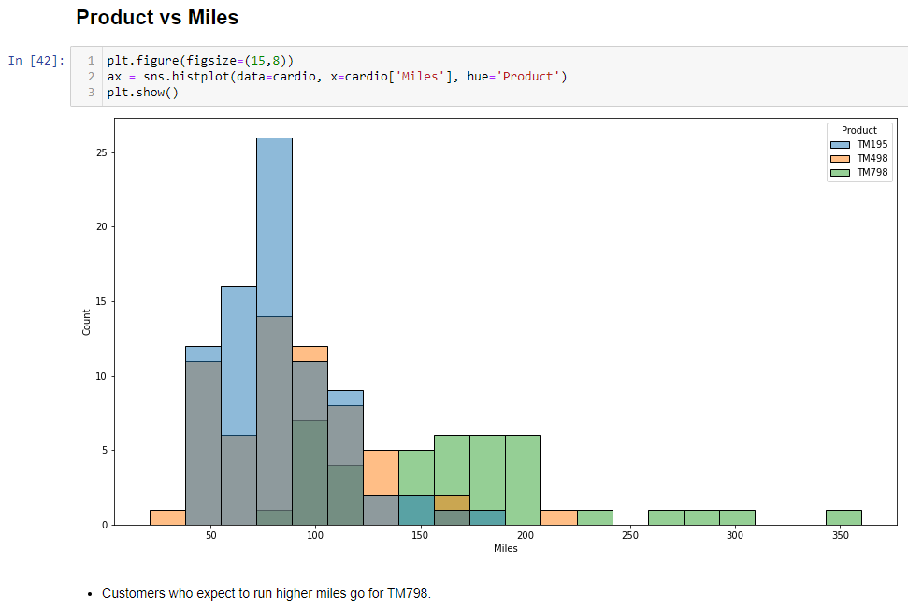

Slide 17
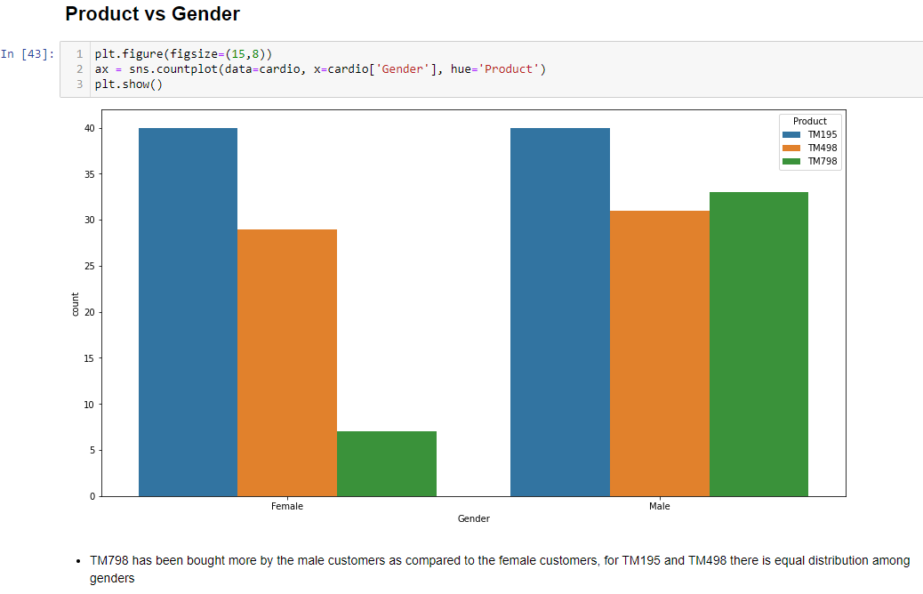

Slide 18
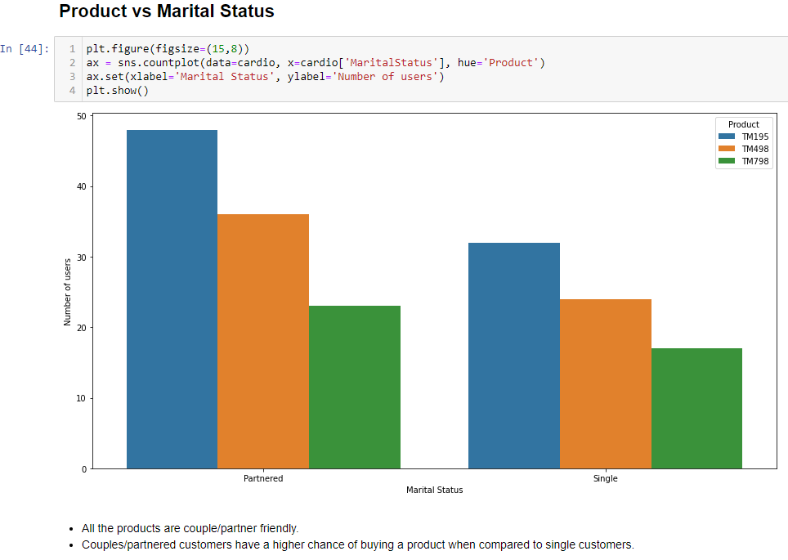

Slide 19
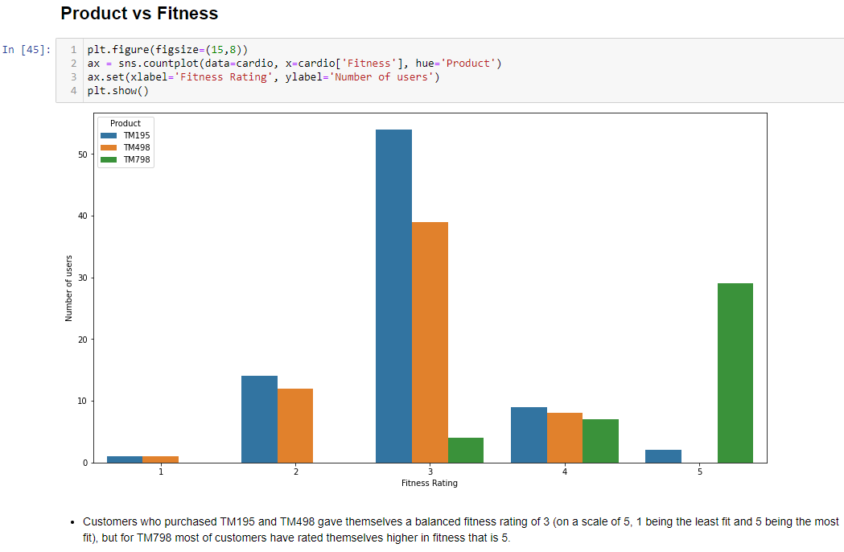

Slide 20
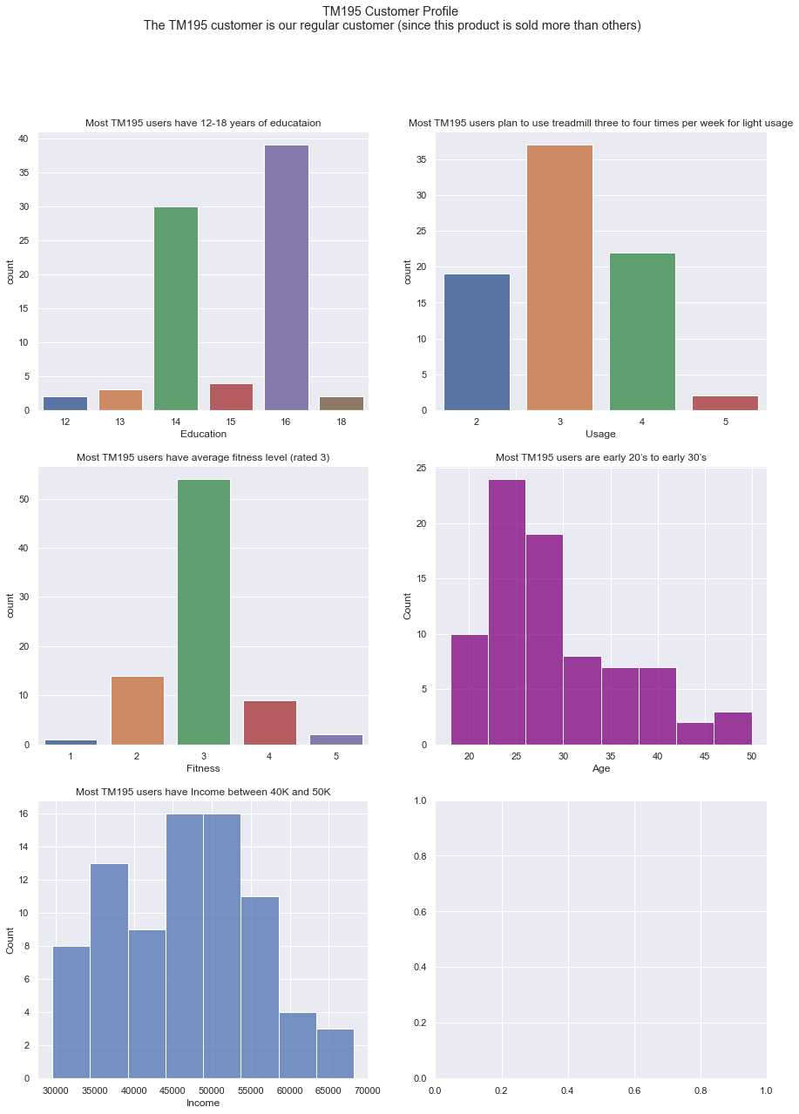
Grouping data w.r.t to products to build customer profile
TM195 Customer Profile
The TM195 customer is our regular customer (since this product is sold more than others)

Slide 21
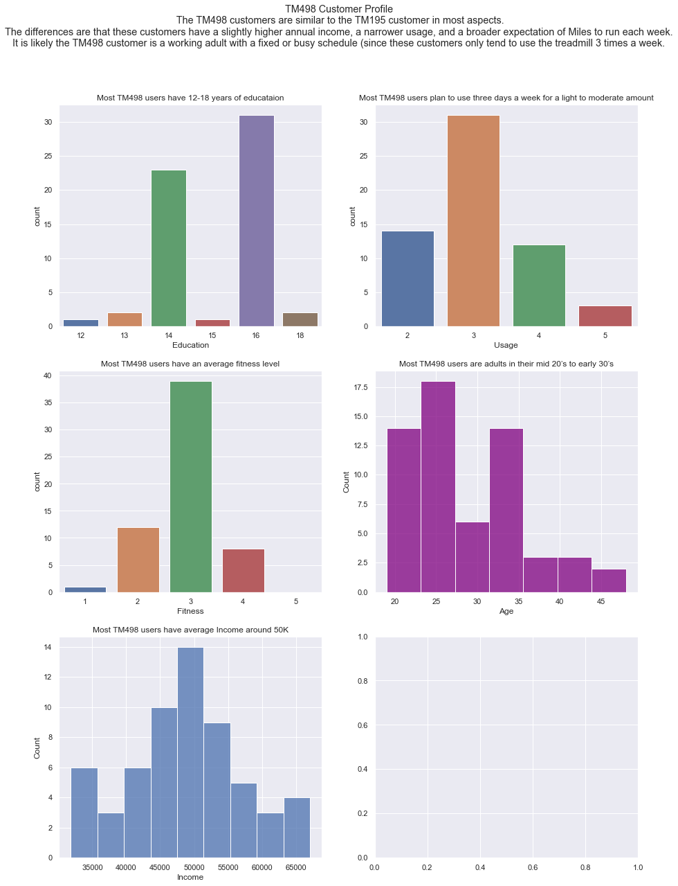
TM498 Customer Profile 1. The TM498 customers are similar to the TM195 customer in most aspects. 2. The differences are that these customers have a slightly higher annual income, a narrower usage, and a broader expectation of Miles to run each week. 3. It is likely the TM498 customer is a working adult with a fixed or busy schedule (since these customers only tend to use the treadmill 3 times a week.

Slide 22
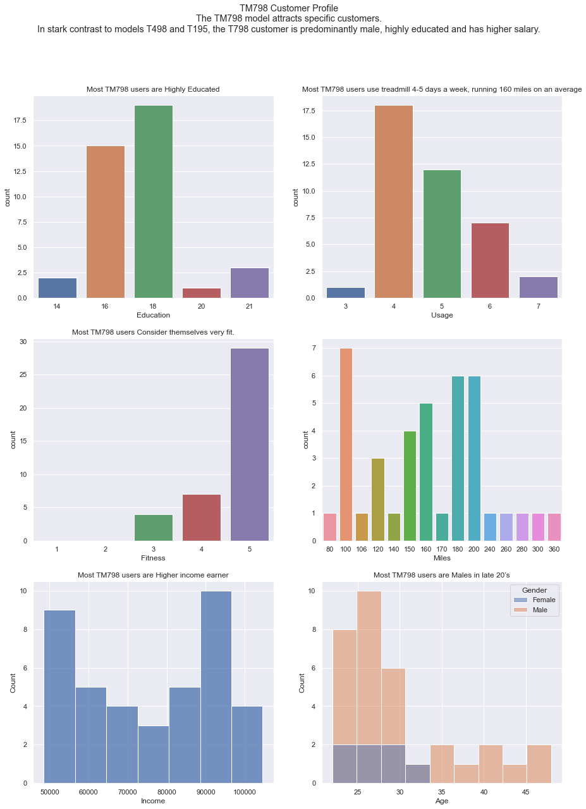
TM798 Customer Profile The TM798 model attracts specific customers. In stark contrast to models T498 and T195, the T798 customer is predominantly male, highly educated and has higher salary.

Slide 23
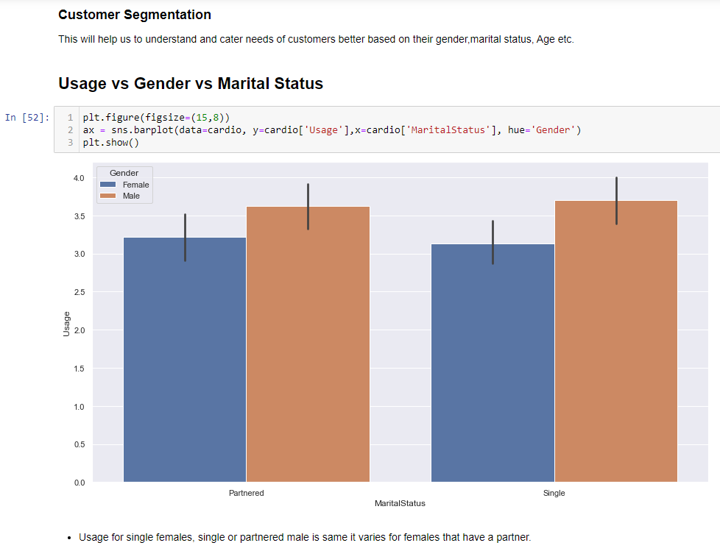
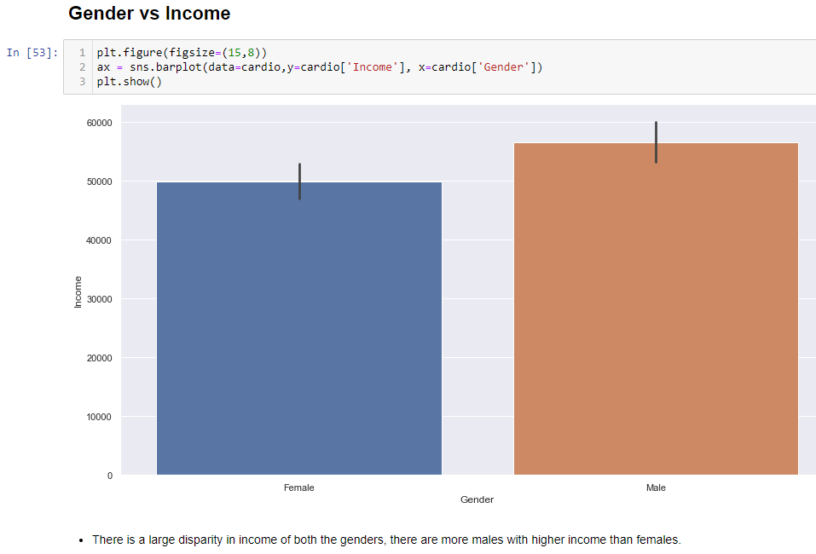

Slide 24
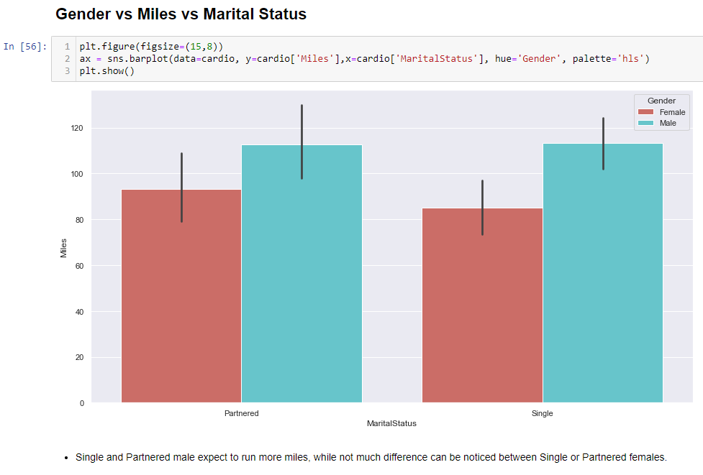
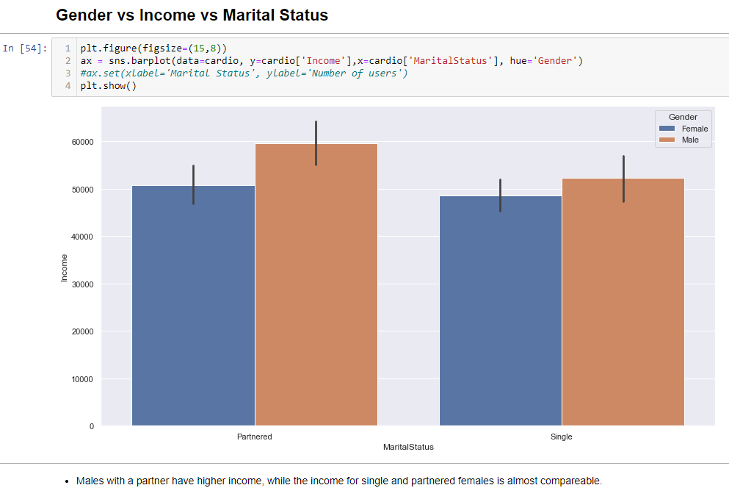

Slide 25
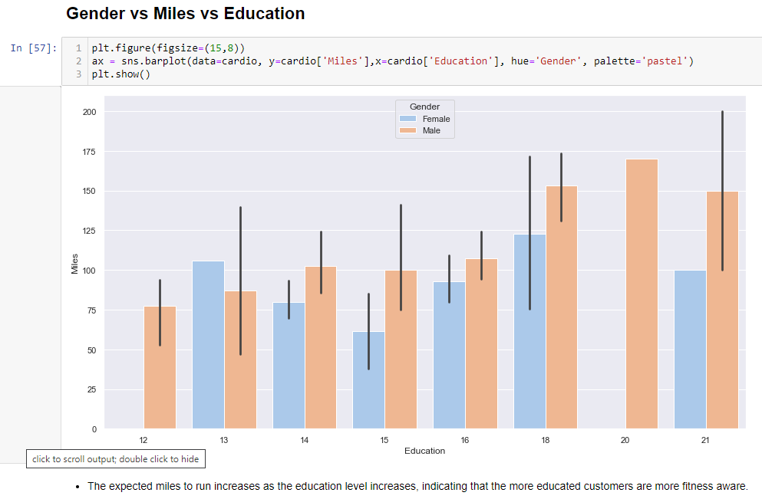

Slide 26
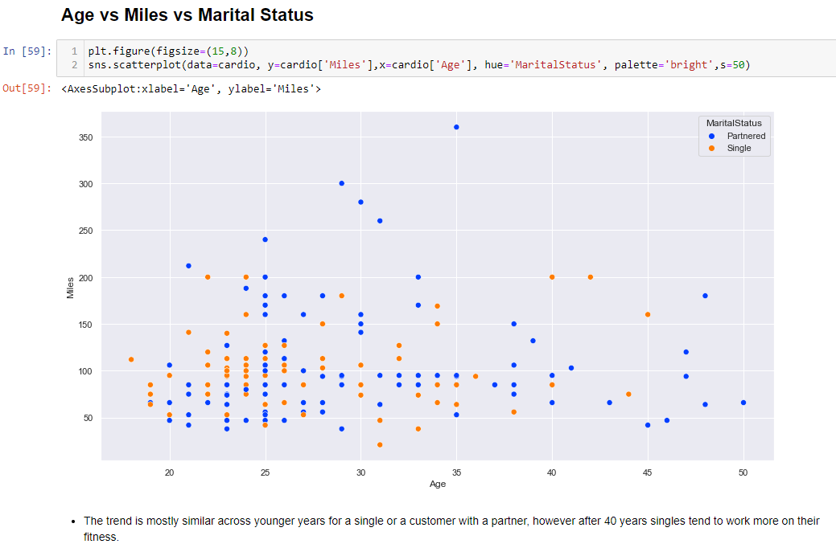

Slide 27
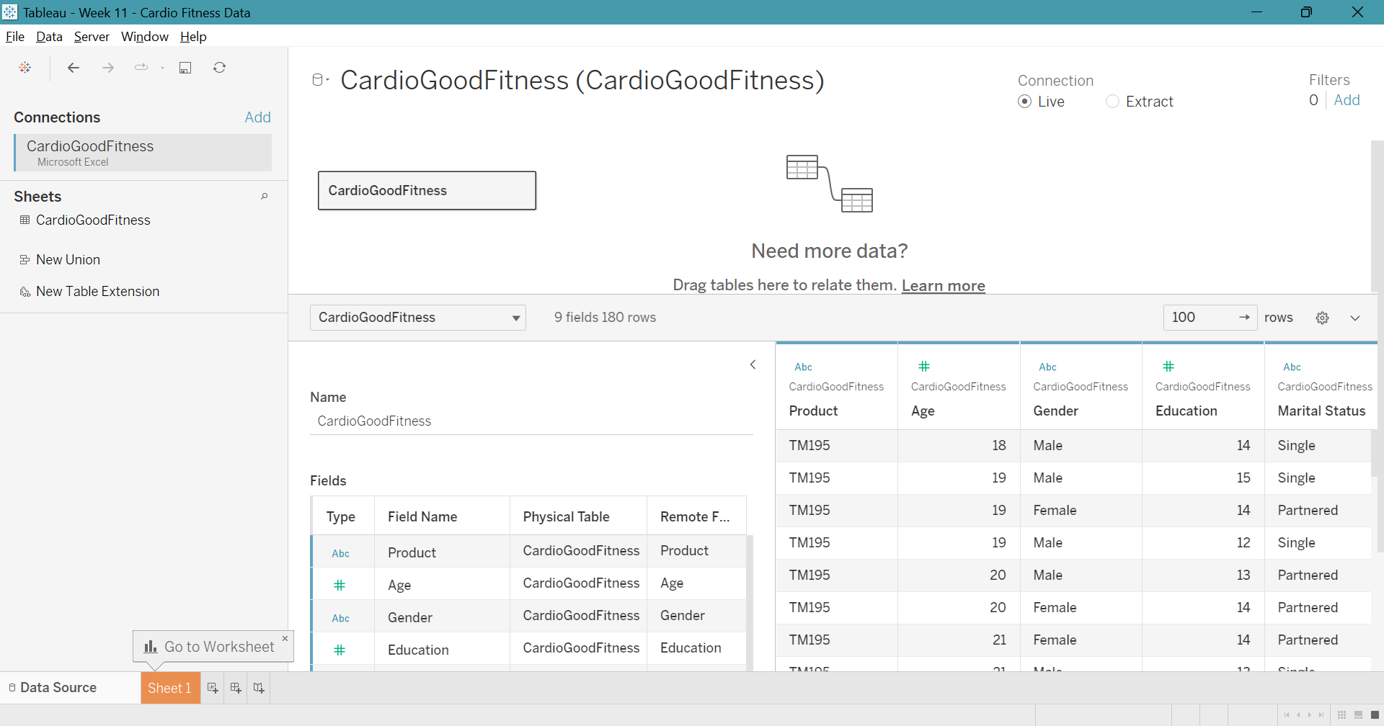
Week 11 – 3rd presentation Tableau Dashboard

Slide 28
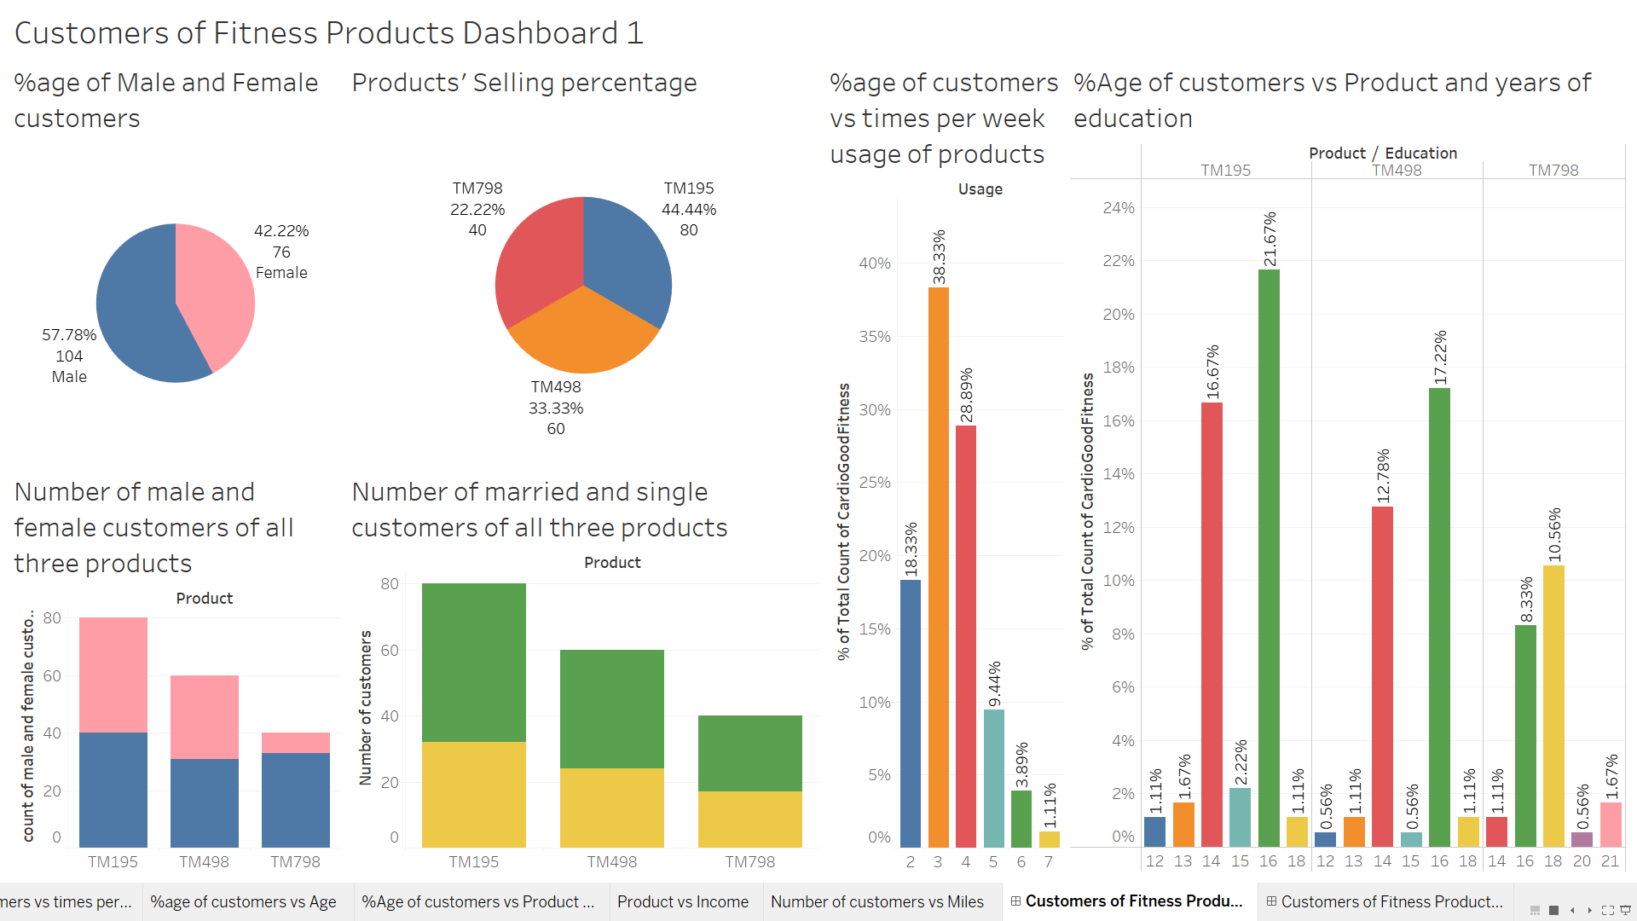

Slide 29
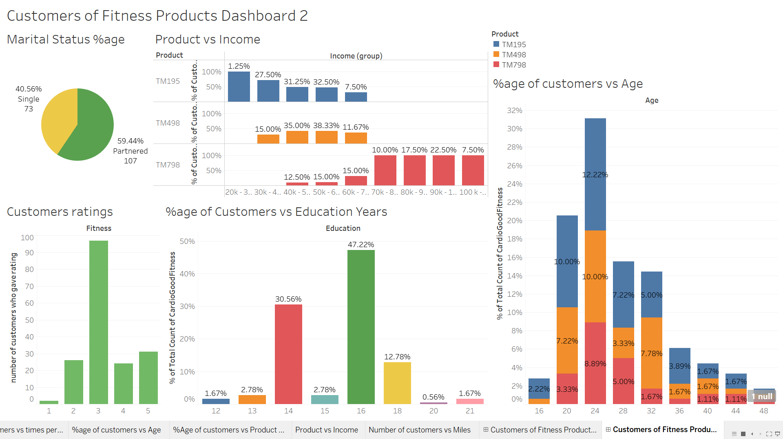

Slide 30

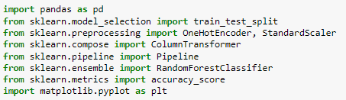


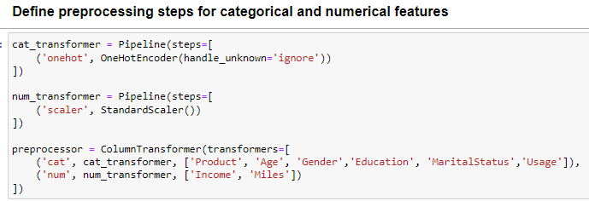
Importing Libraries
ML Model Building
Loading Dataset
cat_transformer applies one-hot encoding to categorical features(Product, Age, Gender, Education, MaritalStatus, Usage) and num_transformer applies standard scaling to numerical features(Income and Miles)
The preprocessor pipeline can be applied to new data to preprocess it in the same way as original data.

Slide 31
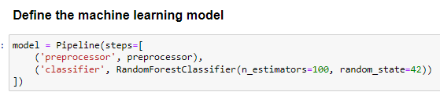
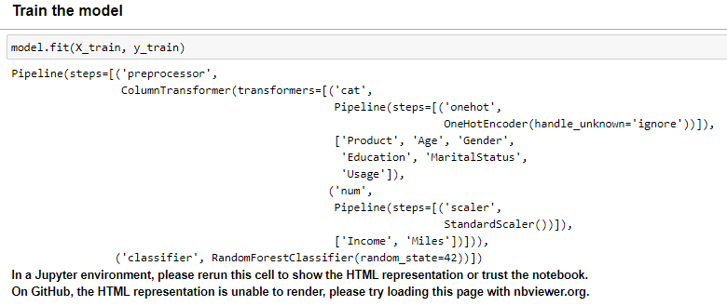
Building Pipeline
RandomForestClassifier classifies data with 100 decision trees and random state of 42.

Slide 32
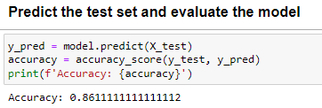
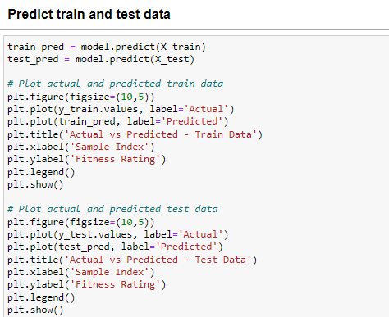
Prediction
The code creates two plots that compare the actual target values to the predicted values for the training data and test data using the predict method and plot function.

Slide 33
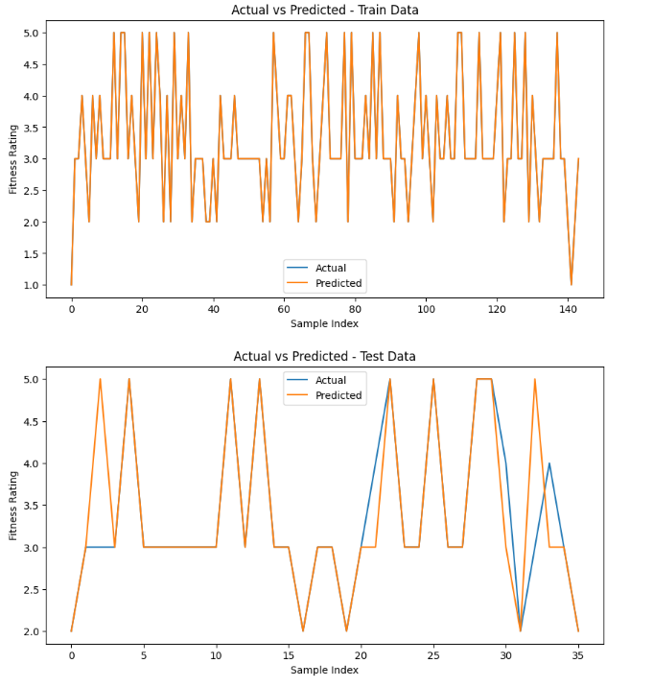
Actual vs Predicted in Train and Test Data
The closer the two lines are to each other, the more accurate the predictions are.
Here, we have the accuracy of 86.11 %.

Slide 34
Summary
Key insights
TM195:
An affordable and general-purpose treadmill that can be used for a wide range of users.
It can be considered as an entry-level product generally targeted for first-time fitness enthusiasts or college-going population.
Customers with light to moderate usage 3 to 4 times a week go for this product.
TM495:
An affordable product like the TM195 with more features and probably has a high price than TM195.
The product also generally targets the same age group as the TM195 but has users of slightly higher income.
The product is used generally 3 times per week.
TM798:
A top of the range treadmill with plenty of features that excite the fitness enthusiasts.
It has a higher price point and probably the flagship product of the company.
The buyers of the product are core users that rate themselves very highly on the fitness score as evident from the usage and expected miles to run.
The buyers in this segment are more educated, have an income(greater than 60k) more than the other two treadmill users, and take their fitness very seriously.
Male customers prefer this product more than females.

Slide 35
Business Recommendations
The company has an affordable product in its portfolio that brings in the bulk of the volume of its sales, which is the TM195. The TM798 is their flagship product that brings in the profits for the company.
The company needs to engage in more marketing to convey that product TM798 is suitable for both the genders and try to lure the younger age group into buying their flagship product. Currently, it seems TM798 is marketed as an exclusive product for the males making more money as there is a large disparity in income for both genders.
Years of education are proportionate to income, and so customers with higher education can be recommended an expensive model(TM798).
Females above 30 years can be recommended the lower end products(TM195 and TM498) since they wish to run a fewer number of miles and therefore the usage of the product won't be higher.
Partnered Females can be recommended all types of products (low end to high end) since their usage varies from 2 days per week to 6 days per week.
Singles above 40 years can be recommended the higher end product(TM798) since they wish to run more miles and therefore the usage would be higher.
Partnered males have a higher income and also expect to run more miles hence the higher end product TM798 would be a good recommendation for them.

Slide 36
THANK YOU !!

